Slide 1
C.A.S.T.L.E
Capacity-Aligned Stable Teaching Location Engine
Matthieu MINGUET
04/11/2024

Slide 2
Table of contents
I
II
III
Current Problem and Market Opportunities
Preferences and utility
Under the engine
3
7
11
IV
V
Results and simulation
modularity
16
22

Slide 3
C.A.S.T.L.E
I
Current Problem Market Opportunities

Slide 4

Current Room Allocation System at X
Tedious & Time consuming : Google Sheets by hand, multiple actors
Arbitrary : Registrars office allocates the room
Single-criteria : Room Occupancy and fit
An ineffective system that doesn’t allow stakeholders to participate
and doesn’t take into account pedagogical needs

Slide 5

Room Allocation System at Clermont SB
Tedious : Done manually by a full-time employee
Difficult: Program directors request room and time slots
Slow: 2-3 month in advance : precise cohort size unknown
Unclear: Central one person clearinghouse, no transparency
A difficult and unclear process but allowing professor input

Slide 6
Global Market Impact and Existing systems
Globally : Universities ~18500 worldwide, ~250m students
Target: Top universities in developed markets : 80 Unis, 2m students
Clearhouses if any are manual : X, CSB, INSEAD, HEC
No papers or advertising of such a system
A broad reach and potential for CASTLE

Slide 7
C.A.S.T.L.E
II
Preferences and Utility

Slide 8
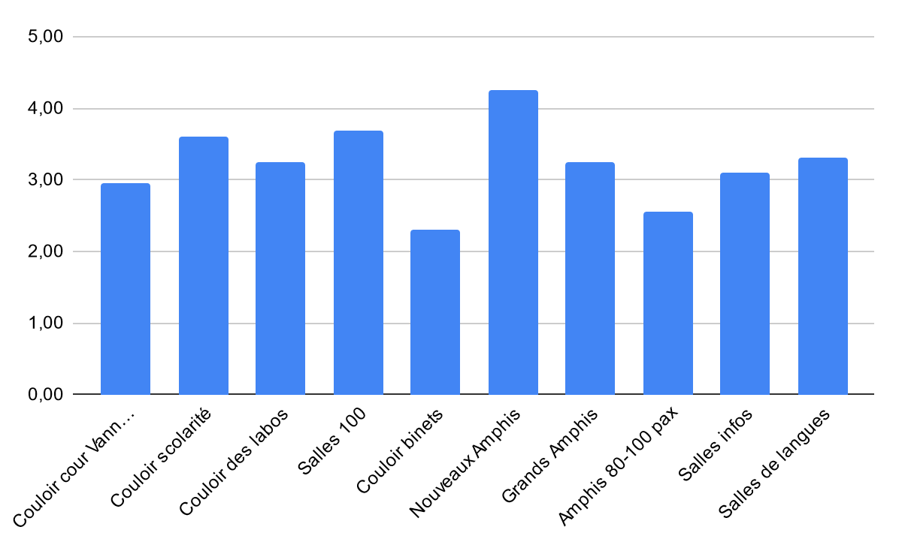
Differences in Room Appreciation
Polling of students
Organized by type
Differences are important, but not detrimental
Relative diversity of answers
Ranking of the room types
Differences in room appreciation warranting optimization

Slide 9
Drivers of differentiation
Room Equipment: screen, boards, sockets, tables…
Room size: lectures vs tutorials
Room Disposition: flat, inclined, isles
proximity to essential: Magnan, coffee, labs
A variety of factors that affect learning and quality of life

Slide 10
Why use CASTLE ?
Professor Side
Administration Side
Profs have a say in the classroom allocation
Prioritize and signal their room preferences
Improve learning and QoL
Ease the load on the Registrar’s office
Efficient allocation of the school’s ressources
Allow quick changes
Considers Professors’ preferences…while being easier to plan out

Slide 11
C.A.S.T.L.E
III
Under the hood

Slide 12
Inputs and core principles
CASTLE
Room Data
Capacity
Type
Course Data
Professor preference
Cohort size
Deferred Acceptance
One to Many
A proven one to many matching system

Slide 13
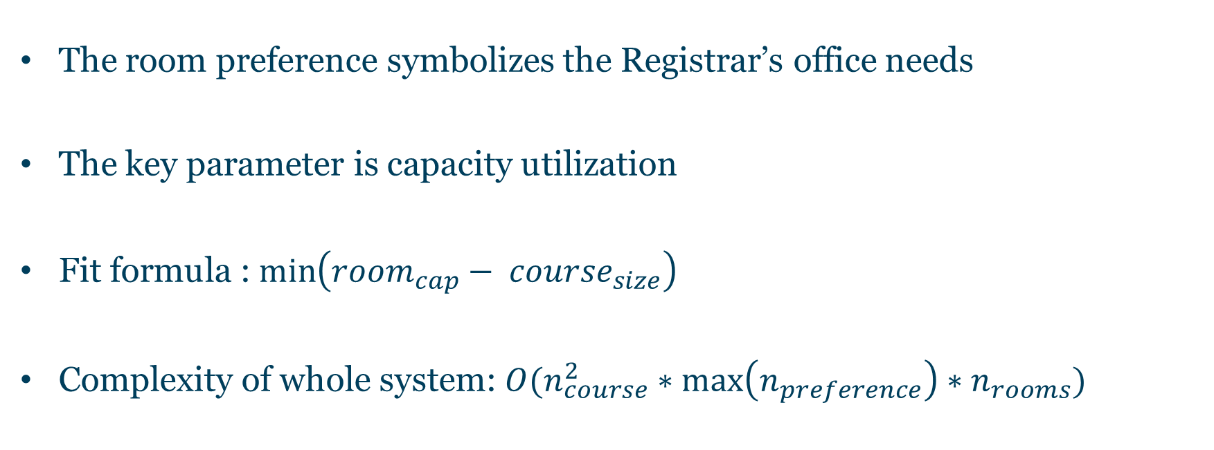
Calculating the Rooms’ preferences
The room preference symbolizes the Registrar’s office needs
The key parameter is capacity utilization
Fit formula : $\min\left({room}_{cap}− {course}_{size}\right)$
Complexity of whole system: $O(n_{course}^{2}∗\max\left(n_{preference}\right)∗n_{rooms})$
Room preferences to consider schools’ priorities

Slide 14
Detailed Algorithm Pipeline
Course Propose to current top room type
Pool of courses per room type, including occupants
Iterate over rooms, choose best fit
Tentatively allocate the room to the chosen course
Remaining courses propose to next type
Continue until all courses are placed or no remaining choices
An efficient and automated process coded in Java

Slide 15
CASTLE Properties
Stability
Pareto Efficiency
Fast and Safe
Strategy-proofness
Strict preferences of Rooms and Professors
Professor proposing DA makes it optimal
Single, confidential and Central Clearinghouse
Professor proposing and fixed cohort size
A system with very good properties, while being fast and with no congestion

Slide 16
C.A.S.T.L.E
IV
Results and Simulation

Slide 17





Different scenarios to test the system
Pure randomness
Randomness among rooms that fit the cohort
Fixed preferences: everyone wants the same thing
Size-based: want the room that fits your cohort size the best
Satisfaction: based on real-life polling
A variety of scenarios to test the system on different aspects

Slide 18
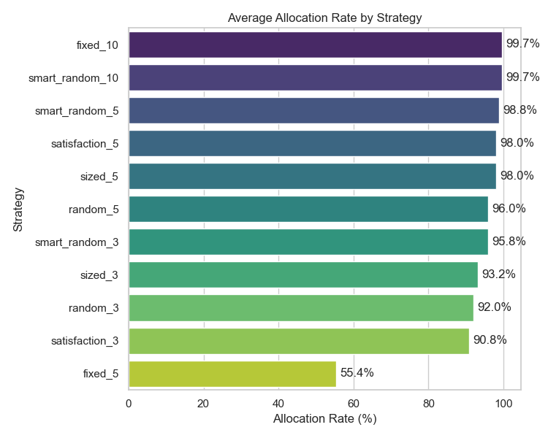
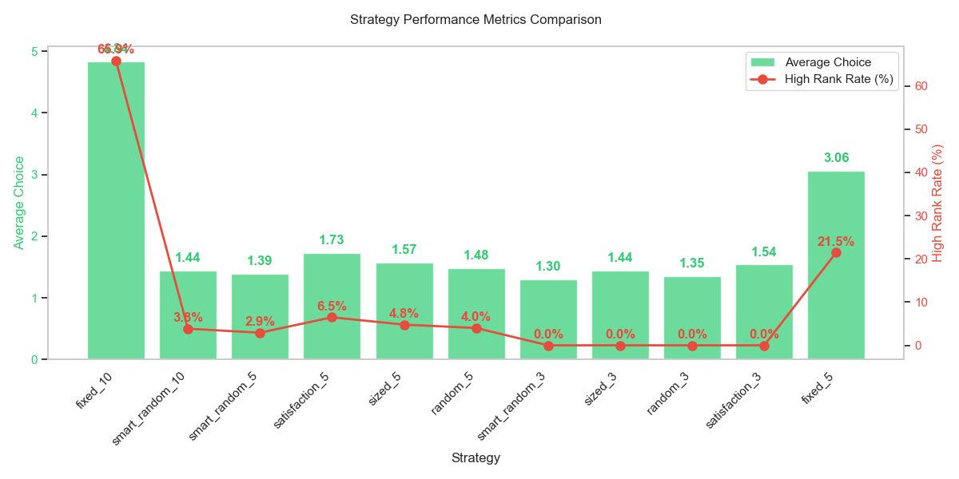
Different simulation representing scenarios
76 rooms, 65 classes, 90% under 35 pax max 200, 20 run averages
Very good allocation rate even at low preference numbers for spread out targeting

Slide 19
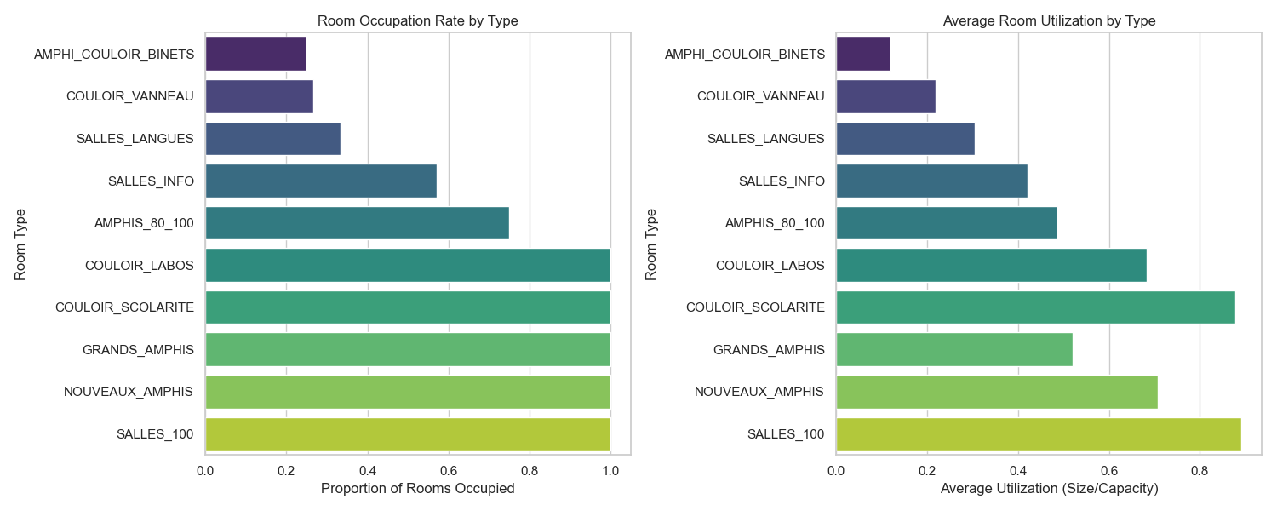
Effect of signaling maximum utilization of resources
Real-life preferences based on pooling ranking
In case where preferences for certain types are shared across the board, maximal utility

Slide 20
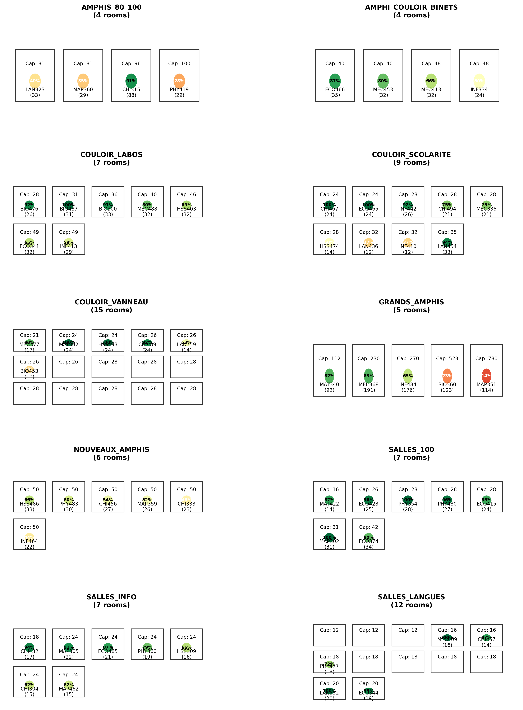
Visual representation
Polling inspired distribution of preferences
40 1st choice, 19 2nd, 10 3rd , 1 4th
All courses allocated
A system that would work when confronted to reality

Slide 21
Fallback
Adding a course is easy : stability, increasing room size priority
Remaining unallocated classes : manually added by registrar’s office, or extension of their preferences
Very few problematic courses: 5 preferences → 95+% allocated
Fringe cases if any are limited and can be resolved

Slide 22
C.A.S.T.L.E
V
Modularity & Conclusions

Slide 23
Other possible fit calculation parameters
Improve fairness : low rank → boost next time (loose strategy proofness)
Equipment matching (loose strategy-proofness, and more unmatched courses)
Proximity to labs/dorms (makes stability harder, improves practical usability)
Include timetable management (makes it much more complex)
The System can be tailored to the administration’s needs

Slide 24





Results of this study
Differences in Room appreciation and utility
Lightweight algorithm and has required properties
Easy fallbacks and strong modularity
One to Many Matching:
Deferred Acceptance
Good Results for both simulated and real-life based scenarios

Slide 25
CASTLE : Conclusion
Simple to use and implement
Very Good Properties
Much needed

